Slide 1
Employee Data Analysis using Excel
STUDENT NAME: Ammu. T
REGISTER NO: 312214980
DEPARTMENT: Commerce
COLLEGE: Soka Ikeda College Arts & Science for women.

Slide 2
PROJECT TITLE
Employee Performance Analysis using Excel

Slide 3


AGENDA
Problem Statement
Project Overview
End Users
Our Solution and Proposition
Dataset Description
Modelling Approach
Results and Discussion
Conclusion
3/21/2024 Annual Review

Slide 4

PROBLEM STATEMENT
"Can we predict employee turnover using performance data and what are the key indicators?"
"How can we use data analytics to identify high-performing employees and develop strategies for retention?"

Slide 5

PROJECT OVERVIEW
.
Objective:
To analyze and gain insights from employee data using Excel, identifying trends, patterns, and correlations to inform HR decisions and drive business outcomes.

Slide 6

WHO ARE THE END USERS?
Organisation.
Employee

Slide 7

OUR SOLUTION AND ITS VALUE PROPOSITION
=IFS (Z2=5"VERY HIGH" Z2 4 "HIGH" Z2 3 "MED" TRUE, "LOW") to calculate
employee performance
PIVOT TABLE - summary
GRAPH-data visuvalization
condition formating - find out blanks
filters

Slide 8
Dataset Description
We took the employee datas from kaggle website.
We have 26 features totally.But, We used only 9 of the features.
We entered the name of the employees in Alphabetical order. And we also enterd the employee type in Alphabetical order.
We entered the performance level of the employee in Numerical value.
We entered the gender of the employees as Male/Female.
We entered the data of employee rating in Numerical value.
We entered the Business unit in Alphabetical order.

Slide 9

THE "WOW" IN OUR SOLUTION
=IFS (Z2=5"VERY HIGH" Z2 4 "HIGH" Z2 3 "MED" TRUE, "LOW") to calculate
3/21/2024 Annual Review
9

Slide 10
MODELLING
Step 1: Input data from (link unavailable)
Step 2: Color columns using Conditional Formatting
Step 3: Color missing data in Exit column
Step 4: Remove missing data in Exit column using Filter
Step 5: Categorize Employee Performance using formula
Step 6: Drag whole Excel and convert into a Pivot Table
Step 7: Analyze table using Pie Chart.
10

Slide 11
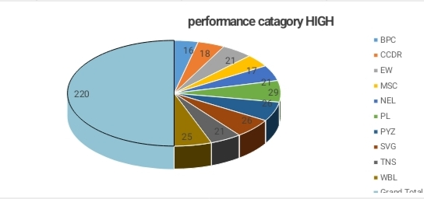
RESULTS
11

Slide 12
conclusion
This employee performance data analysis using Excel has provided valuable insights into the organization's workforce dynamics. By leveraging Excel's data analysis and visualization capabilities, we have

